Slide 1
PRESENTATION ON GOOD AND BAD UI/UX
BAD UI/UX EXAMPLE: Confusing forms
Forms are a crucial part of the user journey,they are used to login,to sign up,check out,etc So its important to provide clear guidance before and after submitting the form

Slide 2
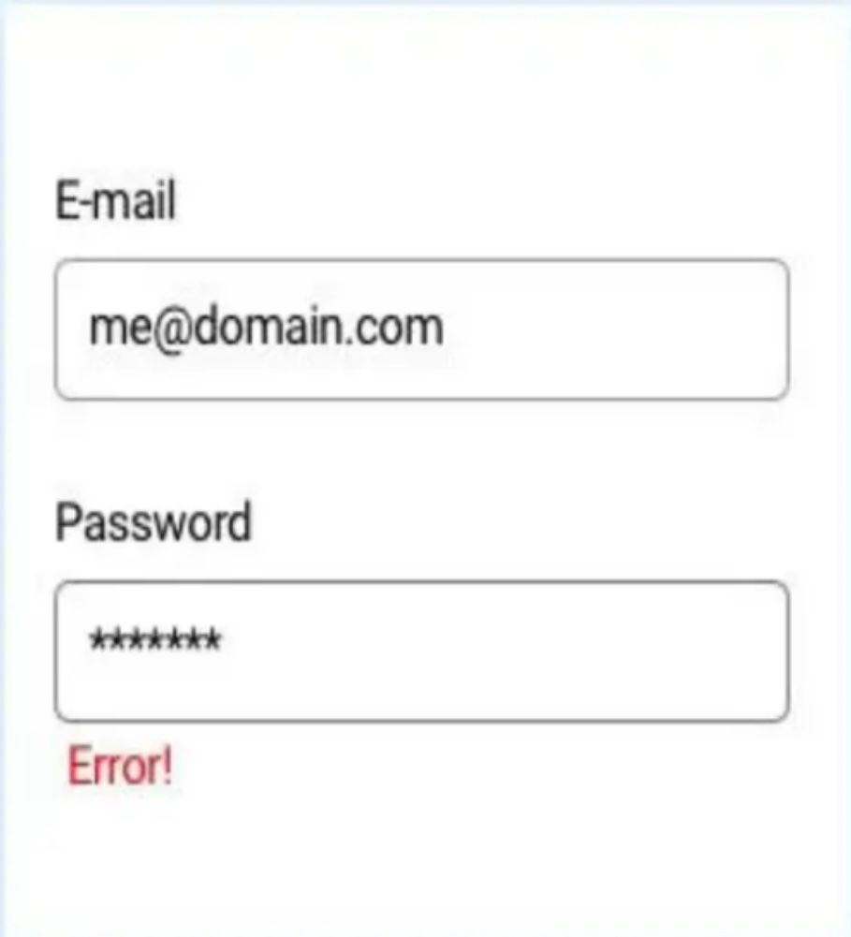

Slide 3
Here are the pointers for bad design in UI/UX
Here are the pointers for bad design in UI/UX
Overcomplicated Navigation
Cluttered Layout
Inconsistent Design Elements
Non-Responsive Design
Unclear Call-to-Action (CTA) Buttons
Poor Contrast and Readability
Lack of Feedback
Overuse of Popups or Modals,Confusing or Unclear Forms
Too Many Fonts and Colors
Lack of Accessibility
Failure to Prioritize Content
Inadequate Error Handling
Slow Load Times
Lack of User Control
Ambiguous Icons and Visuals
Ignoring Mobile Usability
Not Testing with Real Users

Slide 4
Some examples of good UI/UX design that are known for their user-centric approach:
1. Apple’s iOS
Why it’s good: Apple’s iOS is often praised for its minimalist design, intuitive navigation, and seamless integration across all devices. The interface feels consistent, and users can easily find what they need with very little learning curve.
2. Airbnb
Why it’s good: Airbnb's website and app offer a clean and user-friendly design that prioritizes the booking experience. The search bar is easy to access, and the listing pages provide all the necessary details without overwhelming the user. The layout is consistent across platforms, and it’s responsive to both desktop and mobile users.
3. Spotify
Why it’s good: Spotify's interface is simple yet powerful. It offers easy navigation, smart playlists, and a smooth music discovery experience. It adapts well to both mobile and desktop devices, and the consistent use of icons and visual elements makes the app easy to use for new and experienced users alike. 4. Dropbox
Why it’s good: Dropbox excels at minimalism and clarity. Its interface is clean and intuitive, making it easy for users to upload, manage, and share files. Even for non-tech-savvy users, the design is approachable, and the workflow is smooth.
4. Google Search
Why it’s good: Google’s search page is one of the best examples of simplicity. It’s easy to use, fast, and provides relevant results instantly. The minimalist design ensures that the user’s focus remains on the search bar, and everything else is kept to a minimum, allowing for an efficient experience.

Slide 5
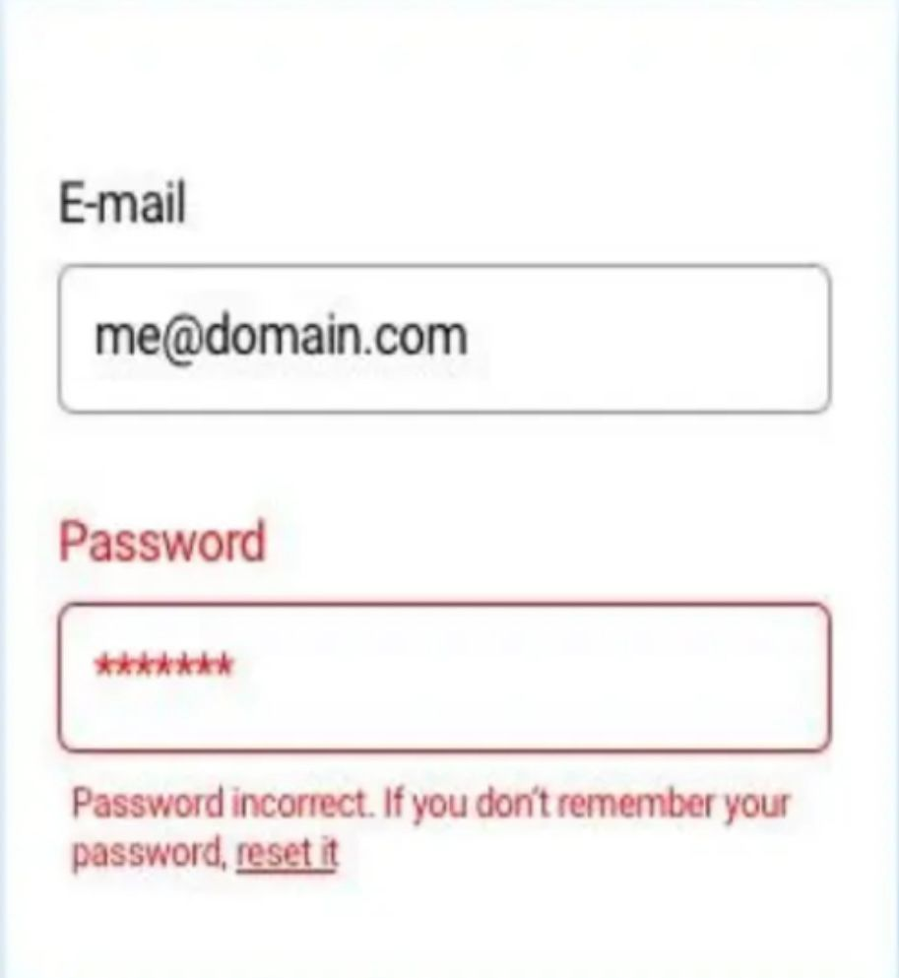

Slide 6
Here are the pointers for good UI/UX
1.User centered design
Consistency
Simplicity
Intuitive Navigation
Responsiveness
Visual Hierarchy
Feedback and Interaction
Accessibility
Fast Load Times
Clear Call-to-Actions (CTAs)
Whitespace (Negative Space)
Error Prevention and Recovery
Personalization
Aesthetically Pleasing Design
Usability Testing
Mobile-First Design
Clear Typography
Data Visualization

Slide 7
THE END

